Slide 1
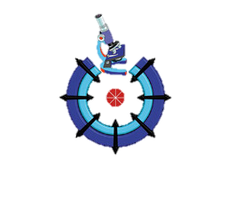

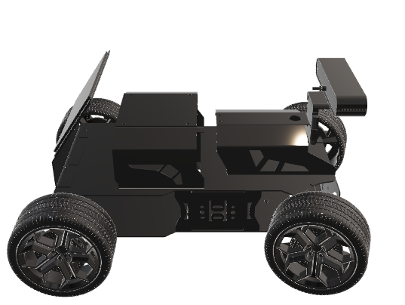
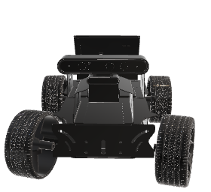
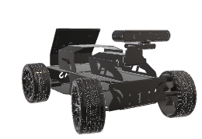
CONCLUSION:
In conclusion, our ADAS project represents a significant advancement in automotive safety and driving experience. By integrating technologies such as blind-spot detection, lane departure warning, traffic sign recognition, adaptive cruise control, and bump detection, we have demonstrated a comprehensive approach to addressing key safety challenges on the road. Through rigorous research, development, and testing, we have not only implemented these systems but also laid the groundwork for future enhancements and innovations in the field of driver assistance. Our project underscores the potential of technology to revolutionize road safety and improve the lives of drivers worldwide. As we continue to refine and expand upon our work, we are committed to making driving safer, more efficient, and more enjoyable for everyone.
Advanced Driver Assistance System (ADAS)
Traffic sign Recognition
Traffic Sign Recognition can interpret and display traffic signs to keep drivers informed about speed limits, no-entry signs, and more.
Implementation:
We use NVIDIA Jetson Nano, Astra Pro Plus Depth camera as our RGB sensor.
We use Custom AI Model based on YOLOv5 to detect different Traffic Signs on the road, we use Python, TensorRT, and OpenCV.
Team Members
Hatem Abdelhamid
Haneen Salah
Abdelrahman Amr
Abdelrahman Mohamed
Mahmoud Mohamed
Fesal Mohamed
Ahmed Mohamed
Toka Hamdy
Youssef Mohamed
Omar Hosny
Supervised By:
Dr. Waleed Abd-Elshafi Ali Elshazly.

Slide 2
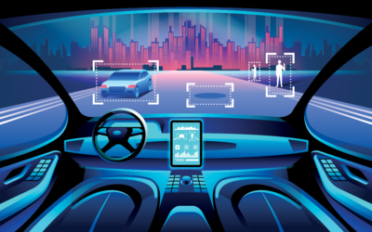
Features:
Adaptive cruise Control
ACC that adjusts the vehicle's speed automatically to maintain a safe distance from the vehicle ahead.
Implementation:
We use NVIDIA Jetson Nano, Astra Pro Plus Depth camera as RGBD sensor and D for Depth.
We use Custom AI Model based on YOLOv5 to detect different vehicles on the road, we use Python, TensorRT, and OpenCV.
Blind Spot Detection (BSD)
BSD technology helps drivers identify vehicles in their blind spots and alerts them to avoid dangerous maneuvers.
Implementation:
We use ESP32 as MCU, and Ultrasonic sensor.
We use C++ to program this feature.
Project Objectives
ADAS can work an important role in many factors to reduce the number of crashes cases as possible using the power of sensors and Machine learning algorithms to analyze the environment around the vehicle and take the required action in the suitable time , these factors are:
Blind Spot Detection System.
Lane Departure.
Adaptive Cruise Control.
Bump Detection.
Traffic Sign Recognition.
Lane Departure
LDW alerts drivers when their vehicle unintentionally drifts out of their lane.
Implementation:
We use NVIDIA Jetson Nano as our main MCU responsible for our ML, Astra Pro Plus Depth camera as our RGB sensor.
We use Python, Python’s libraries such as: OpenCV, and NumPy to implement this feature.
Bumb Detection
Bumb detection systems are equipped to detect and alert drivers of speed bumps and other road irregularities.
Implementation:
We use NVIDIA Jetson Nano, Astra Pro Plus Depth camera as RGBD sensor.
We use Custom AI Model based on YOLOv5 to detect different Bumps on the road, we use Python, TensorRT, and OpenCV.

